Slide 1

Data Driven Education
Discussion Forum Subteam
Presentation 3 - 11/18/2020

Slide 2






Team Members
Andrew Bauer
Data Scientist
Lindsey Blackmore
Project Manager
Web Developer
John Hosmer
Data Scientist
Sambhav Jaideep
Web Developer
Manny Jonson
Data Scientist
Morgan Powers
Project Manager
Web Developer
Notes:
All

Slide 3
Focus for Discussion Forum Subteam
Discussion forums are largely used in college courses especially with the swift transition to primarily online course formats
Student interaction in these forums provides indications of their participation as well as cognitive presence
Metrics and analysis on this information can be leveraged by professors to better grasp their students’ understanding, thoughts on the course/material, and more
Creating a web application to be used by professors will allow the instructors to improve their courses

Slide 4
Data Science Team
Data science team has a somewhat effective model for cognitive presence, but the model will need more work before it’s truly useful
We have provided support for the front end, especially on visualizations
All modelling work has been uploaded into github so future team members can view what has been done and might be able to make improvements to work we have yet to complete

Slide 5
Cognitive Presence Modelling - Intro
Cognitive presence modelling attempts to track how a conversation flows from a triggering event to a resolution within a community of inquiry
The cognitive presence model that we base this work off of^{[7][8]} includes 5 phases: No cognitive presence, triggering event, exploration, integration, and resolution
  These labels are consistent across human labelers^{[6]}
The prior semester provided labeled data which made this work possible
One of the major challenges we are up against is that question asked in the context of a class are dissimilar to other conversation

Slide 6
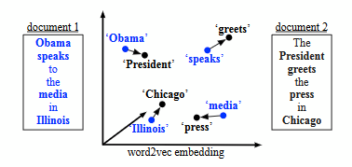
Cognitive Presence Modelling - Word Mover’s Distance
One method that we have used for trying to classify new cases is the word mover’s distance metric^{[5]} paired with a KNN classifier
The word mover’s distance metric compares two documents by measuring the distance between word embeddings from every word in the two documents
For our KNN, we find the closest N
documents and pick the most
frequently appearing one as the
label
The classic WMD example from [5]

Slide 7
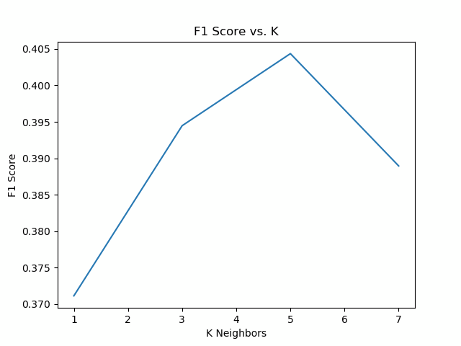
Cognitive Presence Modelling - Word Mover’s Distance
We have applied this method to the new dataset that was labelled by Dr. Lee and team
Results are marginally better when we compare the new dataset to the holdout set from initial dataset (Cohen’s Kappa .212 vs .207, F1 Score .404 vs .360)
Alternate distance metrics and data transformations did not significantly improve the fitness of the model

Slide 8
Cognitive Presence Modelling - Word Mover’s Distance
The overall impression at the end of the semester is that the Word Mover’s Distance model is not going to provide the results that we desire
The work transforming the data and adding in more data will be helpful as we test out other models
The f1 score improvements seen in WMD lead us to believe that more data will be helpful as we attempt to model this data in the future regardless of model

Slide 9
Cognitive Presence Modelling - Transformers Recap
What are transformers?
  Provide thousands of pretrained models to perform text classification, information extraction, question and answering, and many more tasks
What is huggingface?
  A python API that provides state of the art NLP models back by the PyTorch and TensorFlow deep learning libraries
  Allows one to quickly download and use pretrained models to fine tune them on specific datasets

Slide 10
Cognitive Presence Modelling - BERT
First pass at BERT
  Although a lot of the work was done for us, the fine tuning and validation step was very time consuming
  Our results show that BERT is bias towards the mean
    1st guess - most popular, 2nd guess - second most popular, etc.
  We believe the results may be skewed due to lack of data

Slide 11
Cognitive Presence Modelling - Other Transformers
XLNet and GTP2
  Wrote the scripts for both methods and tested locally
  Due to AWS Educate authentication problems, we have not been able to launch a robust experiment
Preliminary results from local tests
  All models tend to be biased towards the mean and yield a low accuracy score
  If more data can be gathered, the transformer results may improve

Slide 12
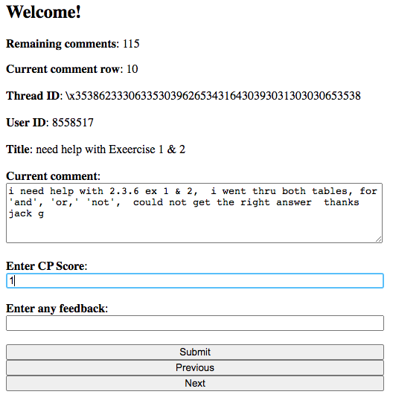
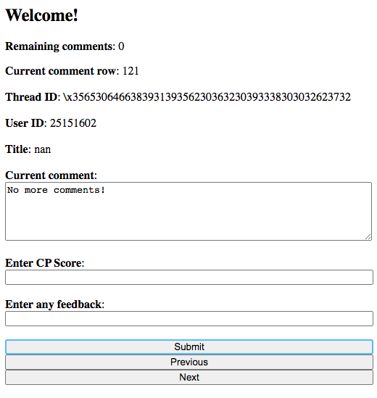
Cognitive Presence Modelling - Data Collection Web App
Notes:
This web app was written using flask and dynamically loads content to easily accelerate the data collection process for cognitive presence labelling
Once a cognitive presence model is ready for deployment, the webapp can be used to synchronously train the model and inspect the models behavior

Slide 13
Cognitive Presence Modelling - Next Steps
Revisit transformers if computing resources and more data are made available
Research other cognitive presence classification models^{[1]}
Tie in cognitive presence results to front end
Improve documentation for next semesters students

Slide 14
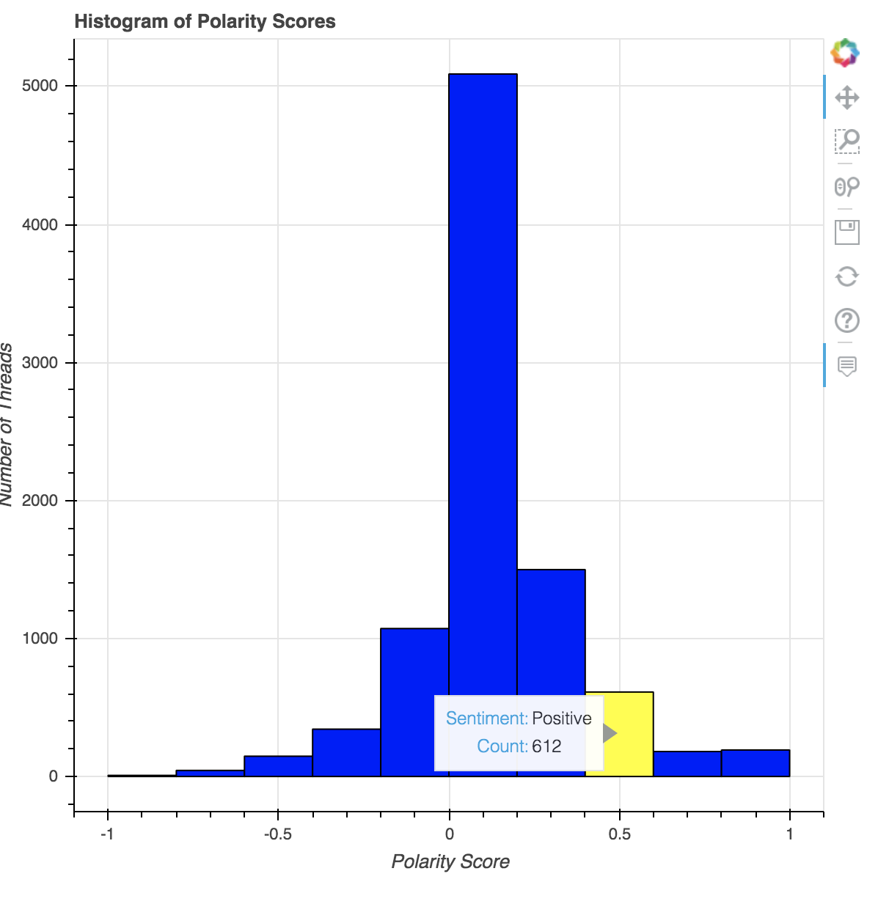
Polarity and Subjectivity
Improved the data visualization for assigned polarity scores
Used bokeh library instead of matplotlib due to interactive elements
Consolidated the histogram and bar chart from before

Slide 15
Polarity and Subjectivity- Next Steps
Histogram could be more visually appealing
Adjust output format to desired format of the web development team
Integrate into web application

Slide 16
Web Development
Restructured web application to have a Flask backend and a React frontend
Created mini relational databases of the edX data
Explored dynamic routing within the application
Thoroughly documented the web development work as well as what the next steps should be
Provided mockups for engagement metrics

Slide 17
Web Development Stack
After experimenting with different approaches, we’ve settled on a certain “stack”
Frontend: React.js
  makes it easier to create cohesive appearance
  includes HTML, CSS, Javascript
  allows for templates & dynamic routing
Backend: Flask
  to connect database to frontend
    SqlAlchemy and SQLite
  is the most flexible (Node.js?)
  data visualizations
Database: MySQL

Slide 18

Web Application Demo

Slide 19
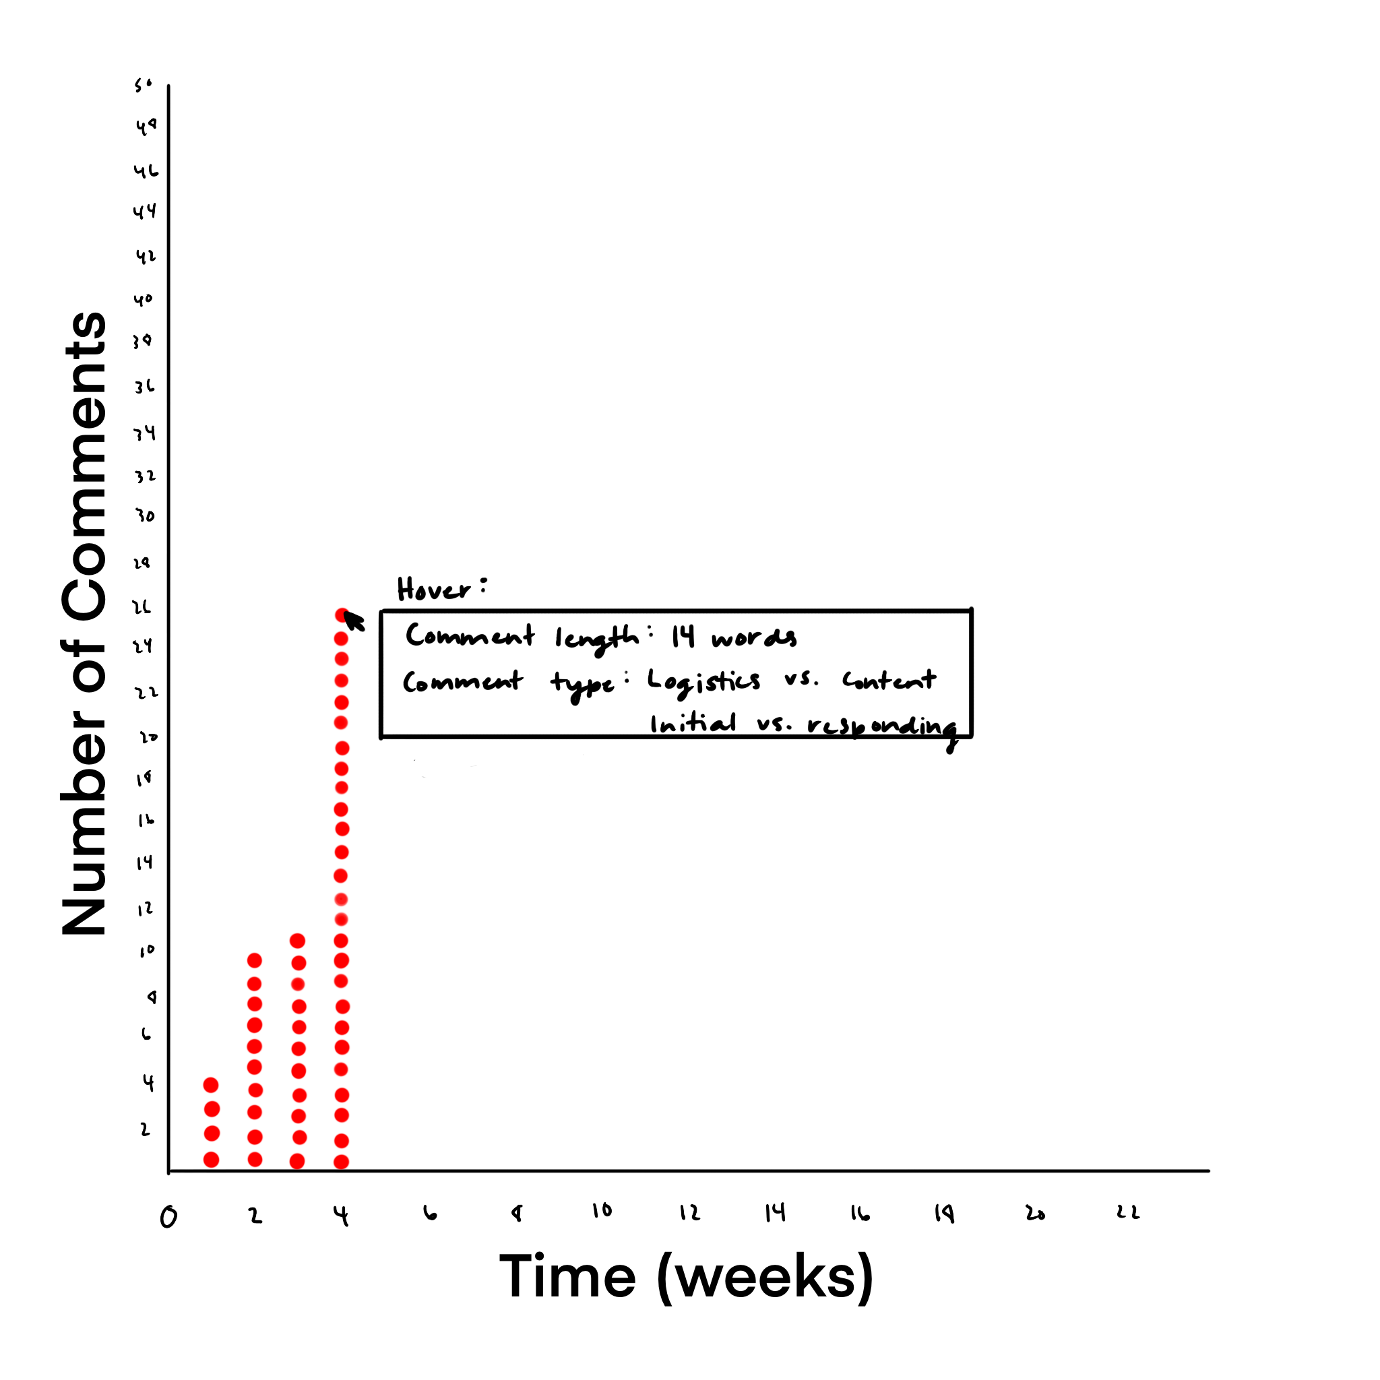
Data Visualizations - Engagement

Slide 20
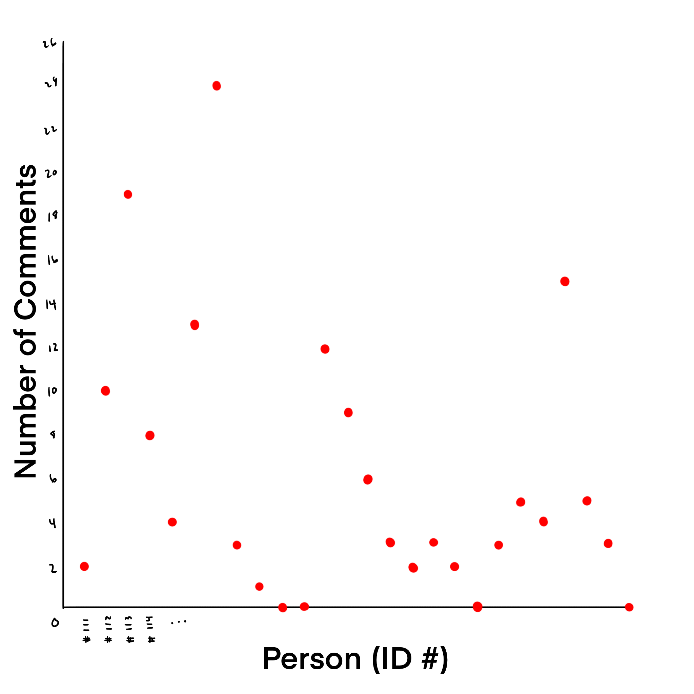
Data Visualizations - Engagement

Slide 21
Web Development - Next Steps
Integrate the edX databases into the backend of the project so dynamic routing can be utilized
Add data visualization scripts to the web application
Include cognitive presence with an explanation of the concept and phases
Utilize Piazza and Canvas data

Slide 22
Key Takeaways
Inter-team communication and project alignment is helpful
Trello boards are useful when maintained properly
  current progress is reflected
  backlog provides insight for future subteams
A mix of waterfall and agile project management is necessary

Slide 23
Citations
Hu, Yuanyuan & Donald, Claire & Giacaman, Nasser & Zhu, Zexuan. (2020). Towards automated
analysis of cognitive presence in MOOC discussions: a manual classification study. 135-140.
10.1145/3375462.3375473.

Slide 24
Questions?

